Slide 1

STUDENT PERFORMANCE PREDICTION SYSTEM
BIT4543 – Artificial Intelligence
Presented by:
Shiam Md Obidur Rahman - 2410-2050
Shahad Muaaz Eltayeb - 2410 - 2468
Rifa Most Nafisa Islam - 2410-2048
Luvenya A/P Nuekey Nicholas - 2410-1699

Slide 2
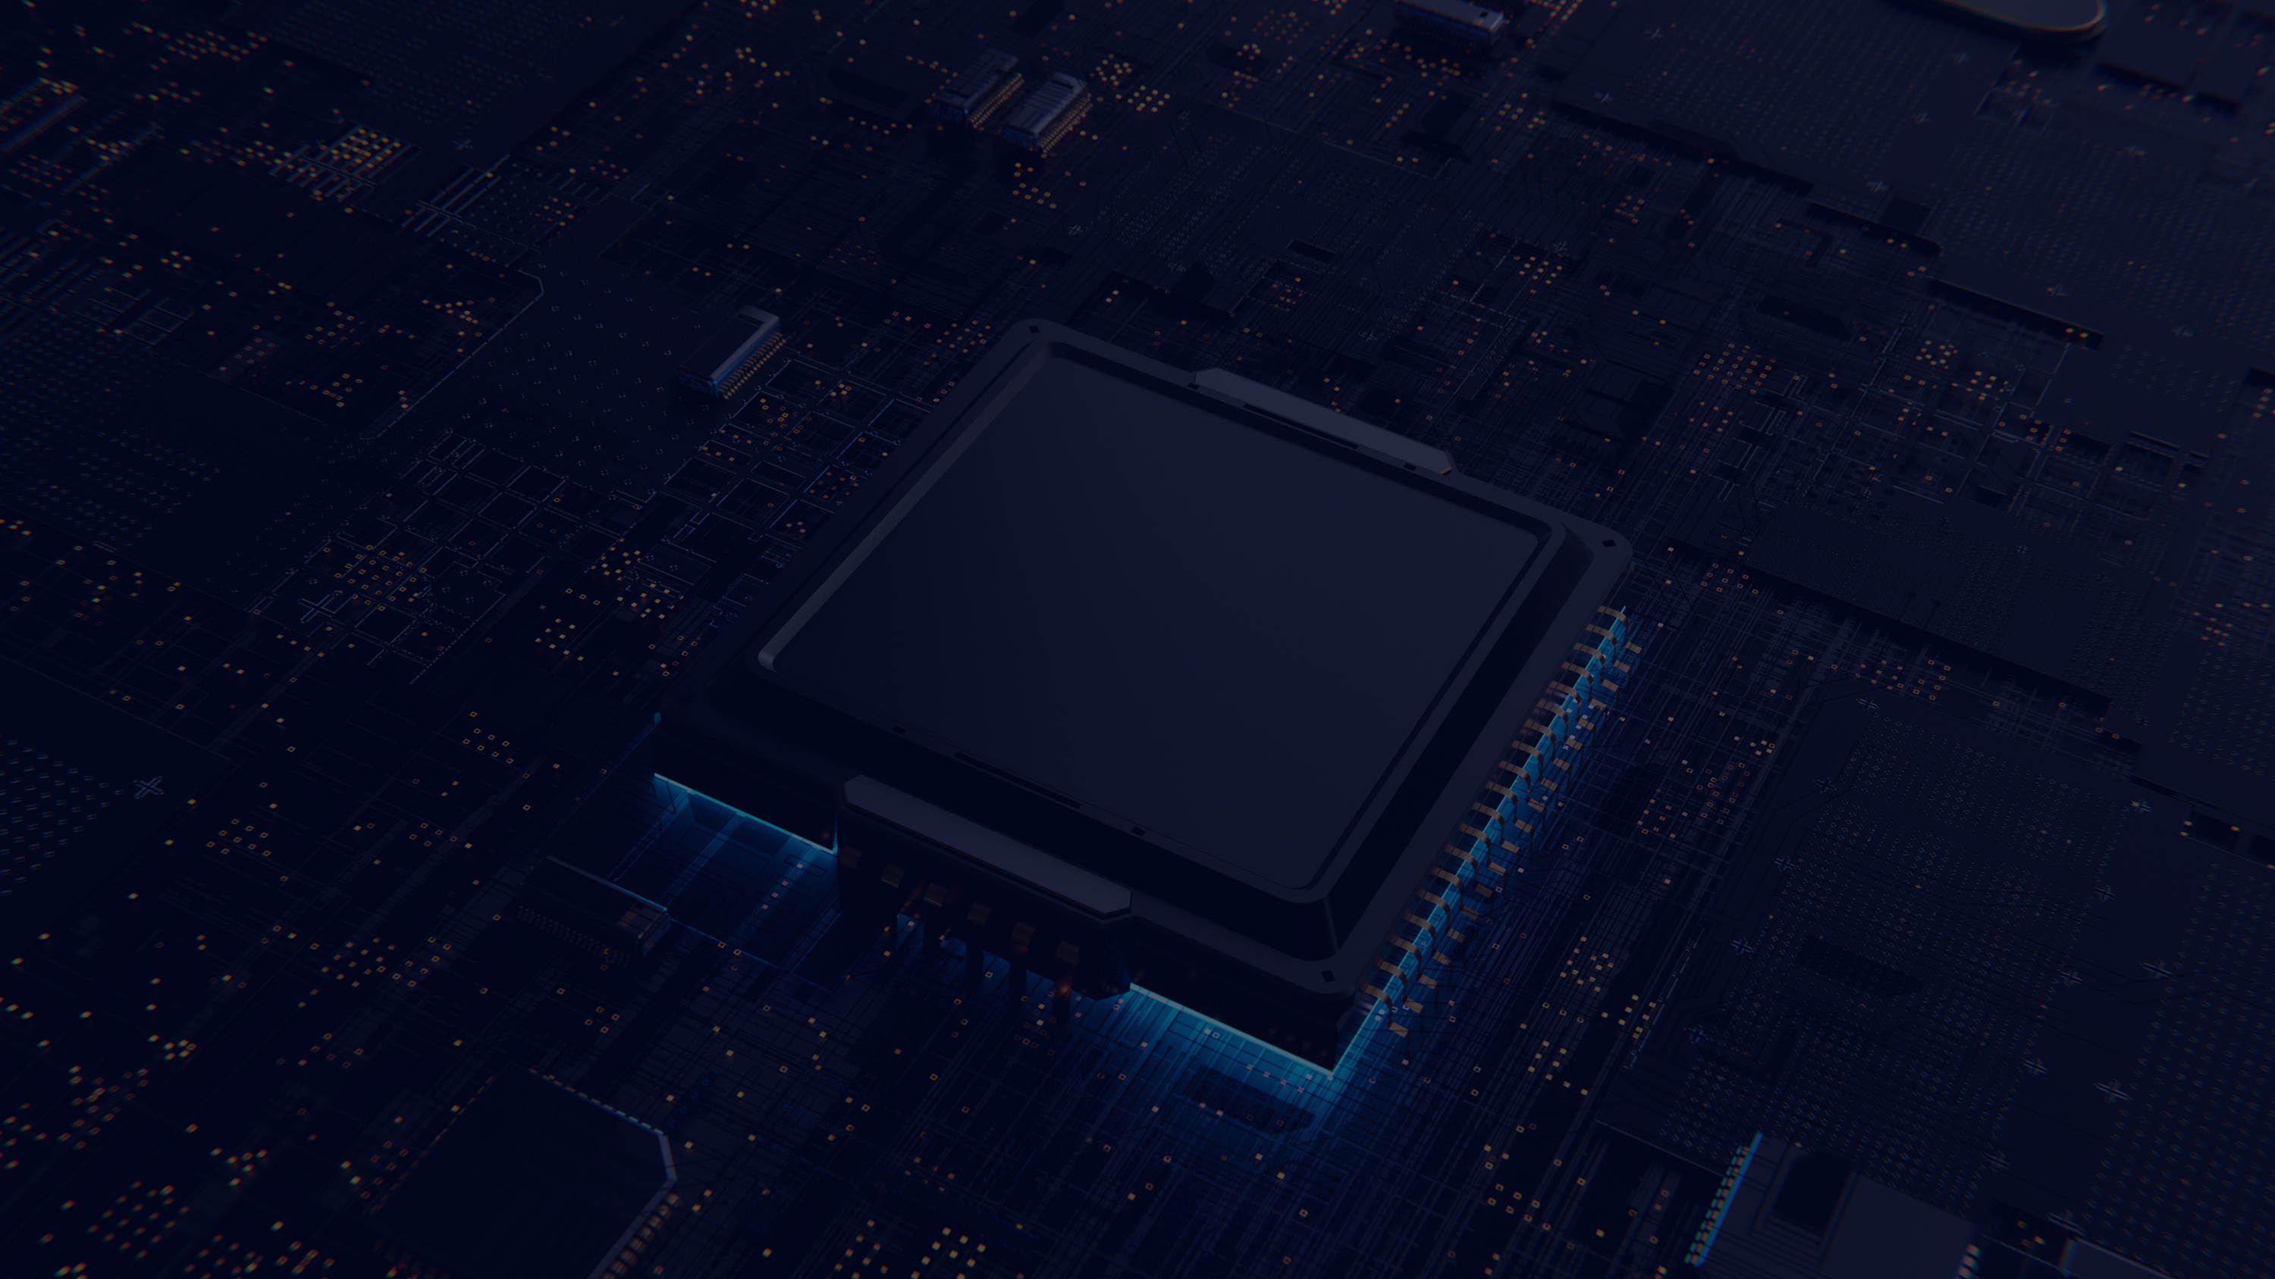

Project Overview
Why Student Performance Prediction?
Educational institutions collect large amounts of student and learning data.
Traditional monitoring often depends on examinations, assessments and manual reviews.
Students experiencing academic difficulties may therefore be identified too late.
AI and Machine Learning can analyse student data and identify patterns.
Early identification can support timely academic intervention.

Slide 3




Problem Statement & Research Gap
Existing Problem
1. Delayed Risk Identification
Students may only be identified after poor examination/assessment results.
2. Lack of Predictive Insights
Manual monitoring does not easily predict future academic outcomes.
3. Ineffective Intervention Alignment
Advisors may know a student is struggling but not which intervention should be prioritised.

Slide 4



Research Gap
Prediction alone is not enough.
A prediction does not automatically tell us:
What factor is causing the risk?
What action should be taken?
How should the recommendation be communicated?
Problem Statement & Research Gap

Slide 5



Project Objectives
Develop an AI-based Student Performance Prediction System.
Prepare and process student data from OULAD.
Develop and evaluate a Random Forest model.
Develop a knowledge base and rule-based risk workflow.
Integrate Generative AI for intervention recommendations.
Develop an application prototype for user interaction.

Slide 6


Data Collection
Open University Learning Analytics Dataset
OULAD provides anonymised educational data, including:
Student information
Course/module information
Registration information
Assessment information
Assessment results
Virtual Learning Environment (VLE) activities
Dataset Scale
32,593 students
22 course presentations
For the final implemented model:
26,074 students → training
6,519 students → testing

Slide 7


Data Preprocessing & Features
Data Preparation
The workflow included:
Data Loading → Inspection → Feature Selection/Engineering → Target Preparation → Train/Test Split
Main Features
Outcome
Dataset Split
The report describes the implemented model as using:
Average assessment score
Assessment count
Studied credits
Number of previous attempts
The final prediction target contains four outcome classes:
Distinction
Pass
Fail
Withdrawn
80% Training / 20% Testing
Training: 26,074
Testing: 6,519

Slide 8


Random Forest Classifier
Why Random Forest?
Suitable for classification.
Works well with structured/tabular data.
Can model non-linear relationships.
Combines multiple decision trees.
Provides feature importance information.
Model Workflow
Student Data
↓
Feature Processing
↓
Random Forest
↓
Prediction
↓
Distinction / Pass / Fail / Withdrawn
Machine Learning Model

Slide 9

OULAD Dataset
↓
Data Processing
↓
Machine Learning Random Forest
↓
Prediction Result
↓
Risk Workflow
↓
Risk Factor Rules
↓
JSON Knowledge Base
↓
Prompt Engineering
↓
Gemini API
↓
AI Intervention Advice
↓
Application UI
System Architecture
Main Layers
Dataset Layer
Data Processing Layer
Machine Learning Layer
Knowledge Layer
AI Workflow Layer
Application Layer

Slide 10


Knowledge Base & Risk Detection
The knowledge base is stored in JSON format.
Three Risk Levels -
Low
Medium
High
Four Main Risk Factors
Low GPA
Poor Attendance
Missed Assignments
Low Participation

Slide 11


AI Workflow & Gemini Integration
1. Student Risk Profile
↓
2. Identify Risk Factors
↓
3. Retrieve Risk-Level Guidance
↓
4. Retrieve Risk-Factor Guidance
↓
5. Build Knowledge Context
↓
6. Add Student Information
↓
7. Apply Prompt Engineering
↓
8. Send to Gemini API
↓
9. Generate Intervention Recommendation
How does the AI generate recommendations?

Slide 12
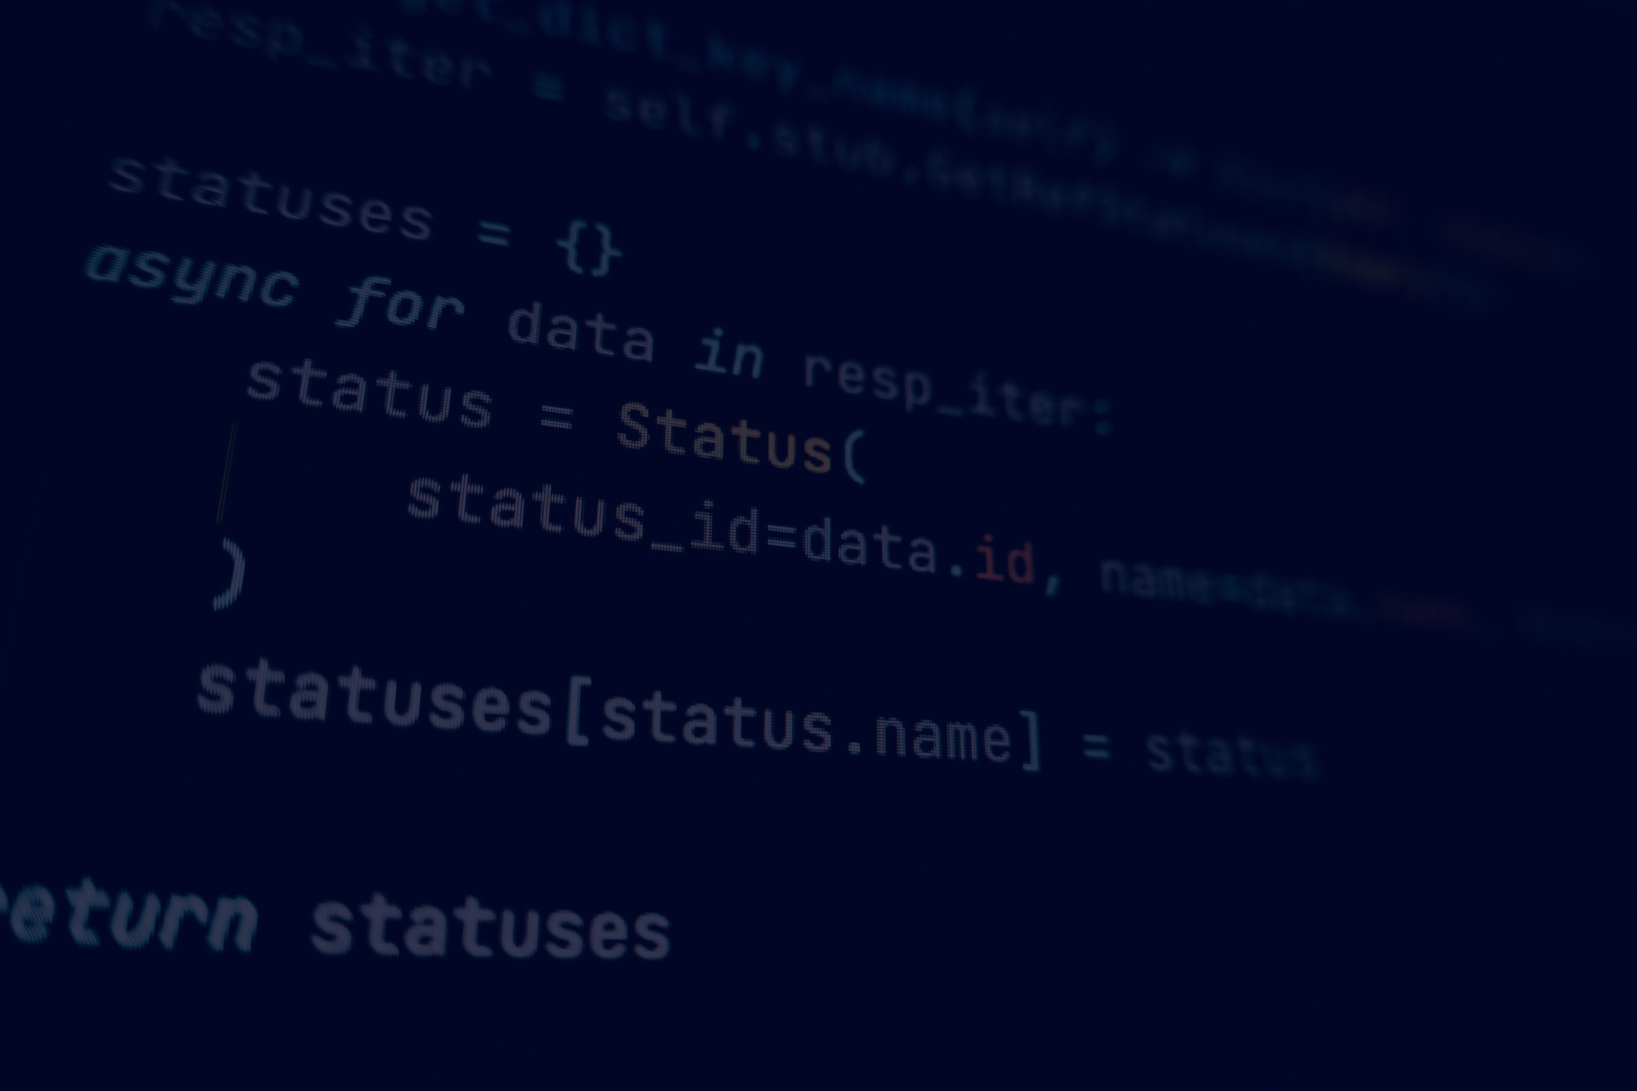
Prompt Engineering
The system uses:
Fixed system prompt
Student information
Few-shot examples
Knowledge-base context
Risk-factor-specific guidance

Slide 13


User Interaction
Basic Workflow
Enter Student Information
↓
Validate Input
↓
Generate Prediction
↓
Identify Risk Factors
↓
Retrieve Guidance
↓
Generate AI Recommendation
↓
Display Results
Application Prototype
Prototype Features
Student information input
Input validation
ML prediction
Risk-factor identification
Knowledge-base retrieval
AI-generated intervention recommendation
Result display

Slide 14

Testing & AI Workflow Validation
Functional Testing
The system tested:
Valid student information
Invalid student ID
Non-numeric input
Empty input
Model loading
Knowledge-base loading
Low-risk profile
Medium-risk profile
High-risk profile

Slide 15
Testing & AI Workflow Validation
Workflow Test Profiles
Risk
GPA
Attendance
Missed Assignments
Participation
Low 3.4 91% 0 8/10
Medium 2.6 78% 2 5/10
High 1.9 60% 4 3/10

Slide 16
Model Performance & Evaluation
Random Forest Results
Overall Performance
Class Performance
Metric Result Class Precision Recall F1
Accuracy 44.62% Distinction 0.36 0.01 0.01
Weighted Precision 0.43 Fail 0.41 0.06 0.11
Weighted Recall 0.45 Pass 0.44 0.73 0.55
Weighted F1-score 0.38 Withdrawn 0.46 0.49 0.48

Slide 17
Limitations & Future Work
Future Improvements
Add VLE activity data
Include assignment submission patterns
Use historical academic performance
Compare XGBoost, Gradient Boosting, SVM and Neural Networks
Apply SMOTE/oversampling
Introduce real-time university data
Improve UI/dashboard
Add database integration
Conduct evaluation with students, lecturers and advisors
Limitations
Moderate model accuracy
Limited feature set
Class imbalance
OULAD represents a specific educational environment
Prototype rather than production system
Rule-based thresholds require validation
Generative AI depends on prompt/context/API behaviour

Slide 18
CONCLUSION
The project successfully demonstrates an integrated AI workflow combining:
Machine Learning + Rule-Based Reasoning + Knowledge Base + Prompt Engineering + Generative AI
The key contribution is moving from prediction alone toward action-oriented academic intervention.

Slide 19
THANK
YOU

